Slide 1
Cryptography and Network Security
Traditional Symmetric-Key Cipher

Slide 2
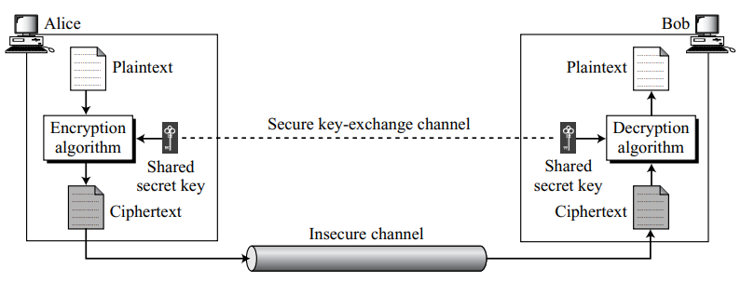
Introduction
The original message from Alice to Bob is called plaintext; the message that is sent through the channel is called the ciphertext.
Alice uses an encryption algorithm and a shared secret key.
Bob uses a decryption algorithm and the same secret key.
We refer to encryption and decryption algorithms as ciphers. A key is a set of values (numbers) that the cipher,
as an algorithm, operates on.

Slide 3

Introduction
If P is the plaintext, C is the ciphertext, and K is the key, the encryption algorithm E_{k}(x) creates the ciphertext from the plaintext.
The decryption algorithm D_{k}(x) creates the plaintext from the ciphertext.
We assume that E_{k}(x) and D_{k}(x) are inverses of each other: they cancel the effect of each other if they are applied one after the other on the same input.

Slide 4
Kerckhoff’s Principle
Based on Kerckhoff’s principle, one should always assume that the adversary, Eve, knows the encryption/decryption algorithm.
The resistance of the cipher to attack must be based only on the secrecy of the key.
This principle manifests itself more clearly when we study modern ciphers.
The key domain for each algorithm, however, is so large that it makes it difficult for the adversary to find the key.

Slide 5
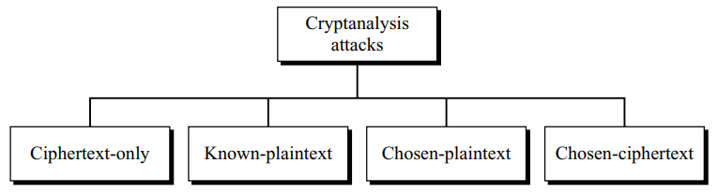
Cryptanalysis
Cryptanalysis is the science and art of breaking those codes.
In addition to studying cryptography techniques we also need to study cryptanalysis techniques.
This is needed, not to break other people’s codes, but to learn how vulnerable our cryptosystem is.
The study of cryptanalysis helps us create better secret codes. There are four common types of cryptanalysis attacks

Slide 6
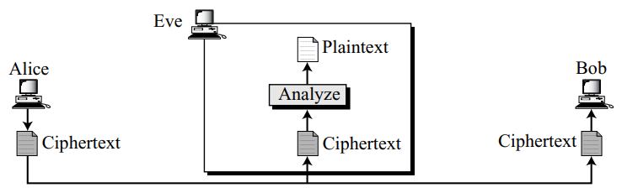
Cryptanalysis
Ciphertext-Only Attack –
  Eve has access to only some ciphertext.
  She tries to find the corresponding key and the plaintext. The assumption is that Eve knows the algorithm and can intercept the ciphertext.
  The ciphertext-only attack is the most probable one because Eve needs only the ciphertext for this attack.

Slide 7
Cryptanalysis
Various methods can be used in ciphertext-only attack.
  Brute-Force Attack – Eve tries to use all possible keys.
  Statistical Attack – The cryptanalyst can benefit from some inherent characteristics of the plaintext language.
  Pattern Attack – Some ciphers may hide the characteristics of the language, but may create some patterns in the ciphertext. So the ciphertext should look as random as possible.

Slide 8
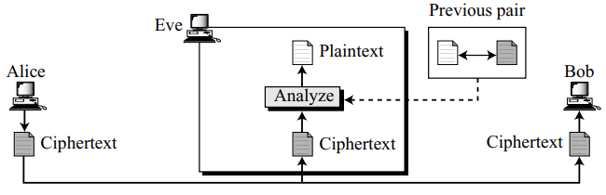
Cryptanalysis
Known-Plaintext Attack –
  Alice has sent a secret message to Bob, but she has later made the contents of the message public.
  Eve has kept both the ciphertext and the plaintext to use them to break the next secret message from Alice to Bob, assuming that Alice has not changed her key.
  Eve uses the relationship between the previous pair to analyze the current ciphertext.
  This attack is easier to implement
  because Eve has more information
  to use for analysis.

Slide 9
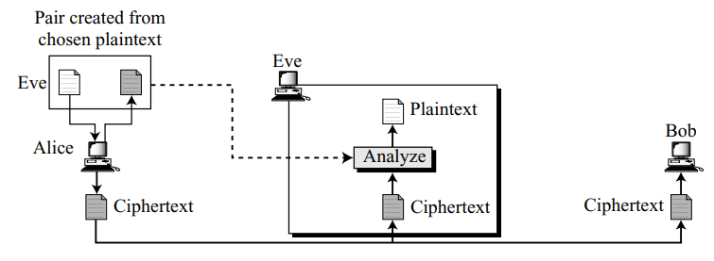
Cryptanalysis
Chosen-Plaintext Attack –
  If Eve has access to Alice’s computer. She can choose some plaintext and intercept the created ciphertext.
  Of course, she does not have the key because the key is normally embedded in the software used by the sender.
  This type of attack is much easier to implement, but it is much less likely to happen.

Slide 10
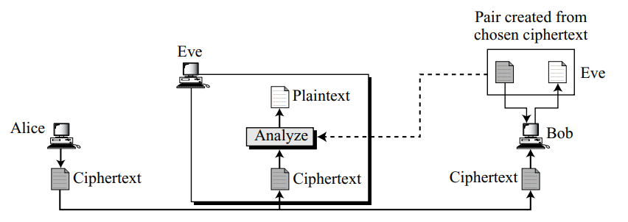
Cryptanalysis
Chosen-Ciphertext Attack –
  It is similar to the chosen-plaintext attack except that –
  Eve chooses some ciphertext and decrypts it to form a ciphertext/plaintext pair.
  This can happen if Eve has access to Bob’s computer.

Slide 11
Substitution Ciphers
It replaces one symbol with another.
Monoalphabetic Ciphers –
  a character (or a symbol) in the plaintext is always changed to the same character (or symbol) in the ciphertext regardless of its position in the text.
  Following is not a monoalphabetic cipher.

Slide 12
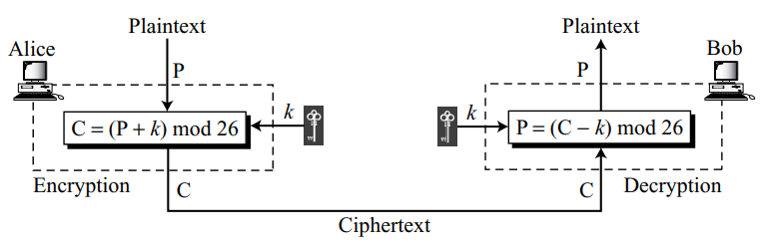
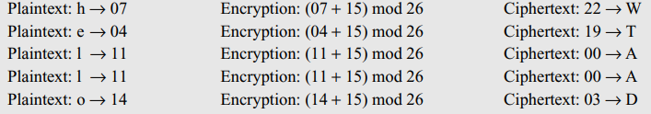
Monoalphabetic Ciphers
Additive Cipher –
  The secret key between Alice and Bob is an integer in Z₂₆.
  The encryption algorithm adds the key to the plaintext character; the decryption algorithm subtracts the key from the ciphertext character.
  All operations are done in Z₂₆.

Slide 13
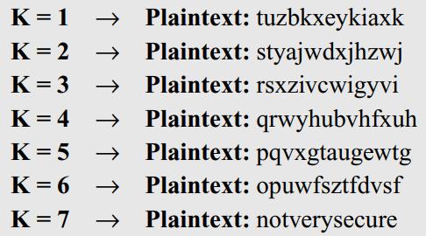
Monoalphabetic Ciphers
Cryptanalysis for Additive Cipher –
  Eve has intercepted the ciphertext “UVACLYFZLJBYL”. Show how she can use a brute-force attack to break the cipher.

Slide 14
Monoalphabetic Ciphers
Cryptanalysis for Additive Cipher –
  Eve has intercepted the following ciphertext. Using a statistical attack, find the plaintext.
  When Eve tabulates the frequency of letters in this ciphertext, she gets: I =14, V =13, S =12, and so on. The most common character is I with 14 occurrences. This shows that character I in the ciphertext probably corresponds to the character e in plaintext. This means key = 4. Eve deciphers the text to get

Slide 15
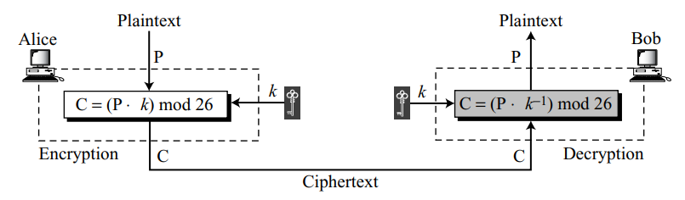
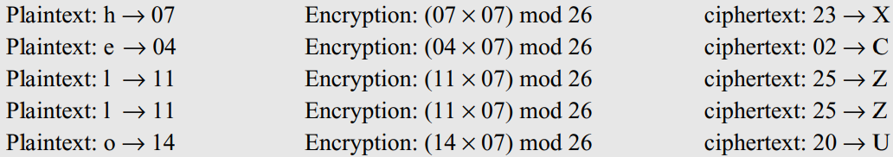
Monoalphabetic Ciphers
Multiplicative Cipher –
  the encryption algorithm specifies multiplication of the plaintext by the key and the decryption algorithm specifies division of the ciphertext by the key.
  However, since operations are in Z₂₆, decryption here means multiplying by the multiplicative inverse of the key.
  Note that the key needs to belong to the set Z₂₆* to guarantee that the encryption and decryption are inverses of each other.

